Slide 1

Judging Policy Debate

Slide 2


Slide 3


Slide 4
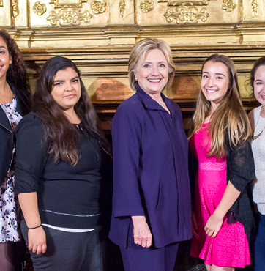
Goals
The Basics of a Policy Debate
How to Choose a Winner
How to Assign Speaker Points
How to Fill out a Ballot

Slide 5
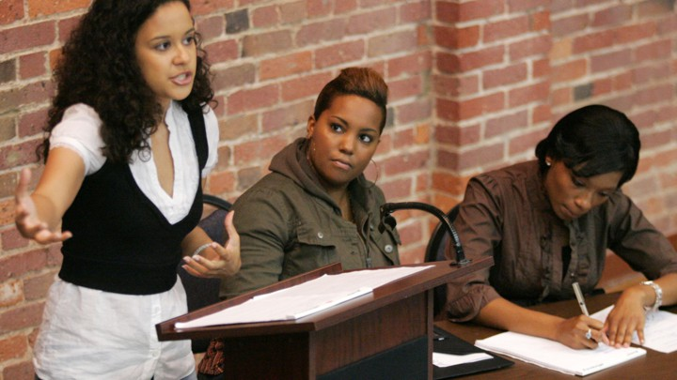
1. The Basics of Policy Debate

Slide 6
The Basics of a policy Debate
Speech Order | Timing:
1st Affirmative Constructive (1AC) | 8 min
Cross Examination | 3 min
1st Negative Constructive (1NC) | 8 min
Cross Examination | 3 min
2nd Affirmative Constructive (2AC) | 8 min
Cross Examination | 3 min
2nd Negative Constructive (2NC) | 8 min
Cross Examination | 3 min
1st Negative Rebuttal (1NR) | 5 min
1st Affirmative Rebuttal (1AR) | 5 min
2nd Negative Rebuttal (2NR) | 5 min
2nd Affirmative Rebuttal (2AR) | 5 min
- There are four 8-minute Constructives
- Each Constructive is followed by a 3-minute Cross-Ex.
- There are then four 5-minute Rebuttals.
Debaters use these speeches to refute or defend already existing arguments
- Debaters have 8-minutes of Prep Time to use before speeches.

Slide 7

THE BASICS OF POLICY DEBATE: TWO JUDGE DUTIES
1. You are the official time-keeper
The one-pager you rec’d has speech order, speech responsibilities and speech times.
2. You should disregard new arguments made in the rebuttals.
New debaters (or tricky debaters) may try to slip in a new argument in a rebuttal. Please disregard this.

Slide 8

BE A CREATOR OF COMMUNITY
Facilitate introductions
Greet debaters
throughout the day
Listen actively
Share your reactions to students’ work and ideas
Push students and celebrate growth

Slide 9
YOUR RESPONSIBILITIES AS A JUDGE
Before
the Round
During
the Round
After
the Round
Head to the room number indicated on your text
Open your ballot and press “Start Round”
Keep time
Listen actively
Take notes
Congratulate students and give verbal feedback
Determine a winner and write an RFD
Assign speaker points

Slide 10

2. How To Choose a winner

Slide 11
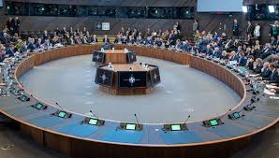
The Resolution
Resolved: The United States federal government should substantially increase fiscal redistribution in the United States by adopting a federal jobs guarantee, expanding Social Security, and/or providing a basic income.

Slide 12
THE TEAMS
Affirmative: For the policy change!
Negative: Against the policy change!

Slide 13

Online Debate!
Judge
First Affirmative
Here is a screen shot from a recent online debate held by SVUDL and our partners.
The zoom room has become a classroom!
You can have students label their “names” by their last name and speech order to make judging easier.
First Negative
Judge
Judge
Second Affirmative
Second Negative

Slide 14
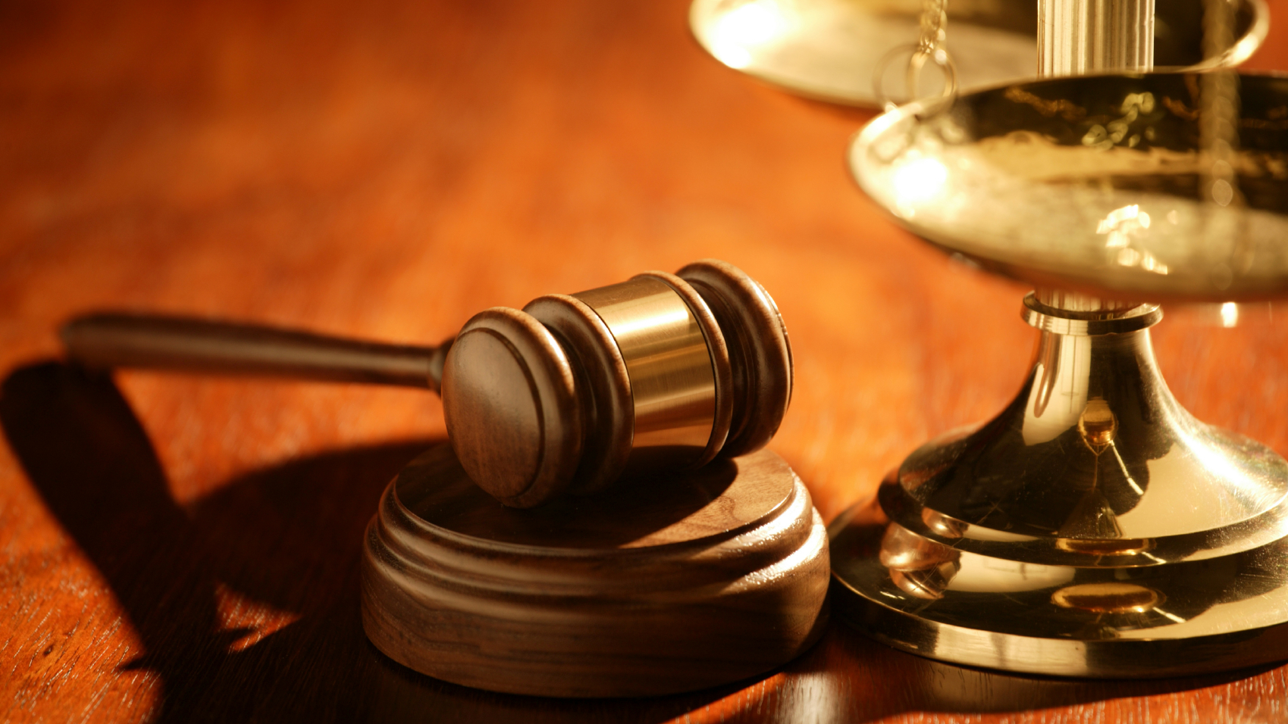
How to Choose a Winner:
The AFFIRMATIVE BURDEN OF PROOF
The Affirmative must win the stock issues:
  There is a significant harm, i.e. a problem causing suffering
  The harm is inherent i.e. current laws or attitudes fail to resolve it.
  A topical plan can address the problem, i.e. a proposal to change the current laws and attitudes
  The plan solves, i.e. it is sufficient to resolve the problem.

Slide 15

How to choose a winner: ThE NEGATIVE BURDEN OF REJOINDER
The Negative can win by doing ANY of the following:
  The Negative can refute a stock issue by showing the affirmative harm isn’t significant, or isn’t inherent, or that the plan cannot solve the harm.
  The Negative can argue that the AFF plan is not a topical example of the resolution.
  The Negative can present a plan that is preferable to the affirmative (a “counterplan”)
  The Negative can demonstrate that the AFF has disastrous unintended consequences

Slide 16


DETERMINING A WINNER
What to Consider
What Not to Consider
Strength of arguments
Claims, reasons, and supporting evidence
Refutation of opponent’s arguments
Your personal opinion
Presentation skills or style
Pronunciation, accent, or reading fluency
Arguments not explicitly made by debaters
Arguments made during cross-ex
Minor points made at the beginning of the round

Slide 17

3. How To assign speaker points

Slide 18
How to assign speaker points
Speaker points are a way judges evaluate individual participants. Wins and losses are assigned to teams, but speaker points focus on individual skill.
Check your judging guide for a more detailed scale. A rough rule of thumb:
  30 – Incredible, near perfect. One of the best speakers in the country
  29 – A very good speaker, California State qualifier, impressive depth of argumentation.
  28 – Average for varsity, made some mistakes but overall was a solid competitor
  27 – A new debater, below average in significant areas of oratory or argument
  26 – Poor, did something unethical or crass
  Scores may shift by tenths of a point
  Low-point win: when the winning team has fewer total speaker points.

Slide 19
COMMON HABITS IN NEW DEBATERS
Developing presentation skills
Pausing while speaking
Stopping early
Looking at opponent’s evidence
Uncertain about whose turn it is

Slide 20
MORE EXPERIENCED DEBATERS
Speak faster
Use terminology for specific types of arguments
May run out of time
May be more competitive with one another

Slide 21
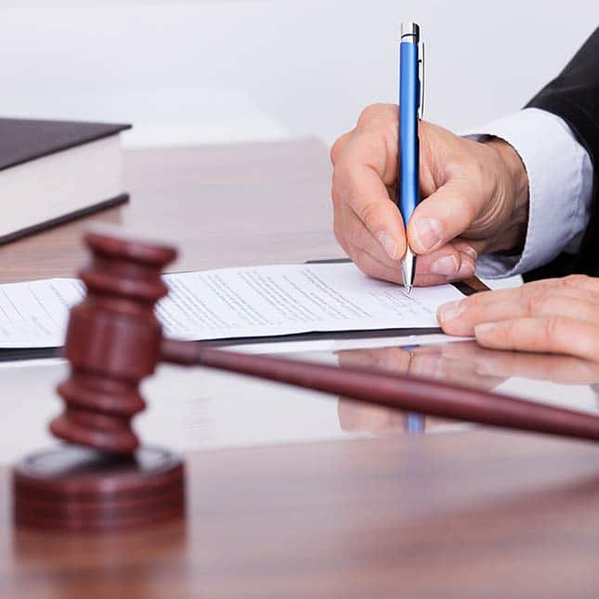
4. How To fill out a ballot

Slide 22
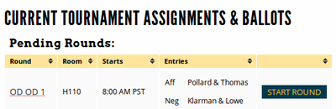
How to fill out a ballot
To see your current ballots, log-in and go to your account dashboard by clicking your username/email in the upper part of the page.
Make sure to click "Start Round" to let the tournament know that you're aware you're judging.
Notes:
Thanks to the Boston Urban Debate League who has provided some of the slides from its own judge training. They have been adapted for use here.

Slide 23
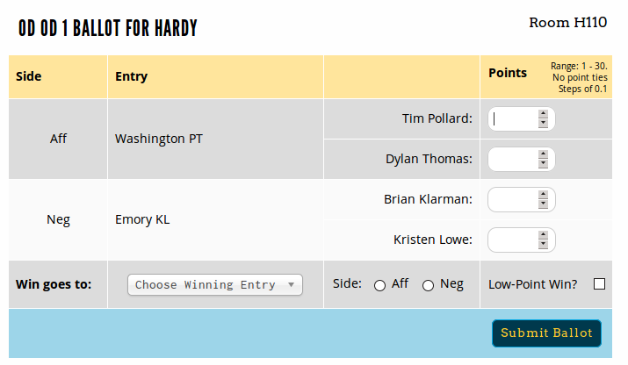
How to fill out a ballot
For each ballot, fill out the speaker points, choose a winner and the corresponding school, then click "Submit Ballot."

Slide 24
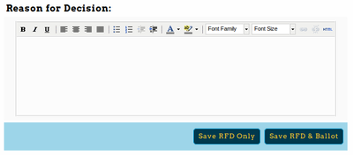
How to fill out a ballot
During the round, before you submit your ballot, you should fill out a Reason for Decision (RFD) below the ballot.
This will be saved and available to competitors and their coaches.
A good RFD is specific. It is typically at least a paragraph, often longer.
A good RFD describes either how the affirmative met their burden of proof or how the AFF was defeated by a NEG strategy.
A good RFD always explains to the losing side what they could have done to win the debate.

Slide 25

HOW TO FILL OUT A BALLOT
After submitting your ballot the first time, you must confirm the ballot - you'll be shown the data you entered the first time, and then the option to confirm or re-enter if you made a mistake.

Slide 26


WRITING A REASON FOR DECISION (RFD)
Strong RFD
Weak RFD
At least 2 sentences
States strongest arguments
Compares or weighs arguments
Explains how enacting the plan would make the world a better place
1-2 sentences
Vague, generic
Doesn’t compare or weigh arguments
Discusses superficial items (presentation, clarity)

Slide 27
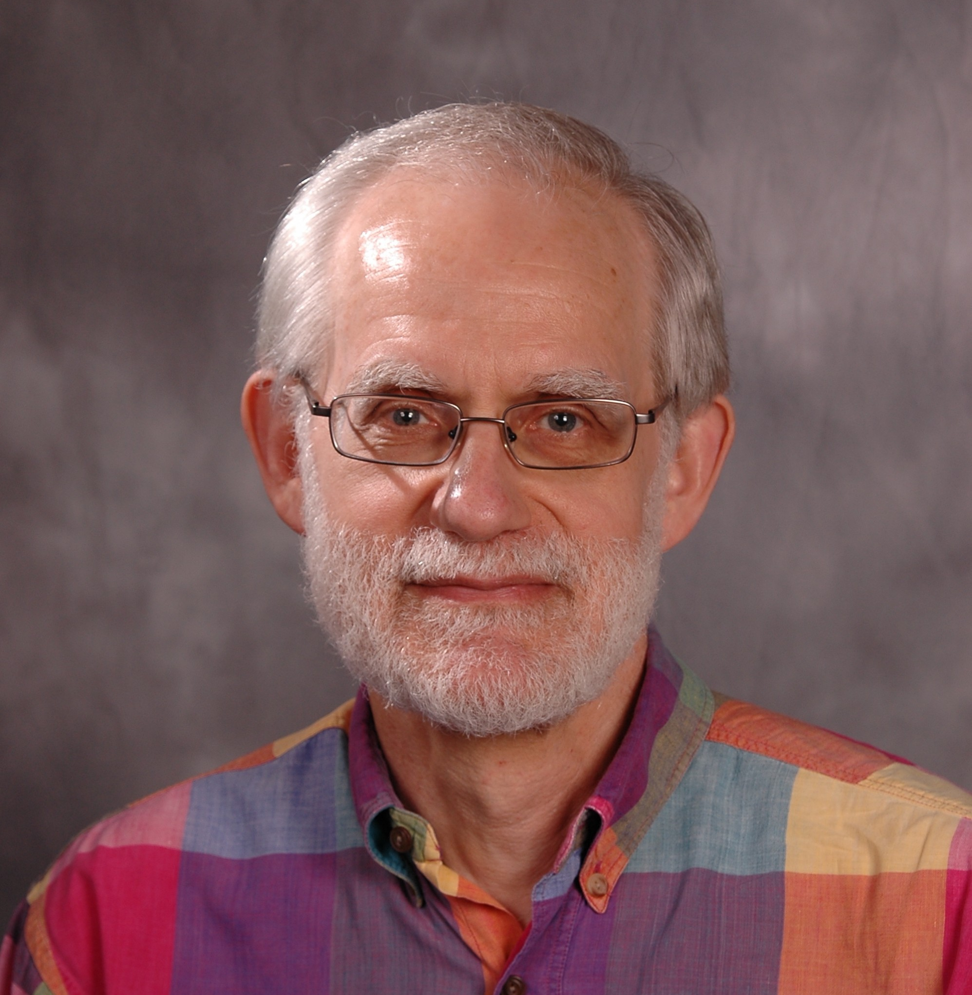
POSITIVE FRAMING…
“You could have been anywhere this Saturday, perhaps you wish you were in your bed sleeping. But you worked hard and came here to participate in the most venerable tradition of American democracy, the public debate. I salute you for it.”
-- Fred Sternhagen
Director of Debate, Concordia University

Slide 28


EXAMPLES OF VERBAL FEEDBACK
Strong Feedback
Unclear Feedback
“I found your argument about ___ persuasive because…”
“Your cross-examination answers supported your arguments well by…”
“You could improve your argument by providing more evidence about…”
“Try to help guide the judge’s decision by explaining why (I) should vote for your team.”
“You were clear.”
“Good eye contact.”
“Be louder.”
“You were very convincing in your speech.”

