Slide 1
JUDGING LINCOLN DOUGLAS

Slide 2
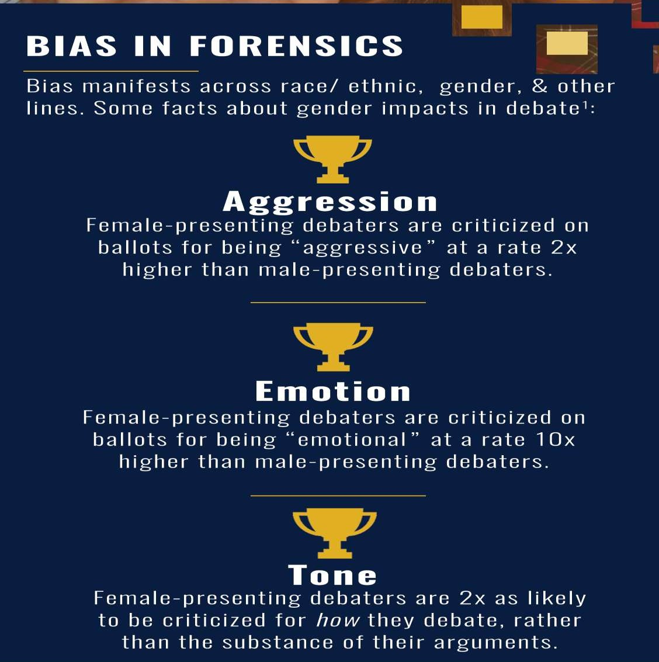

Slide 4
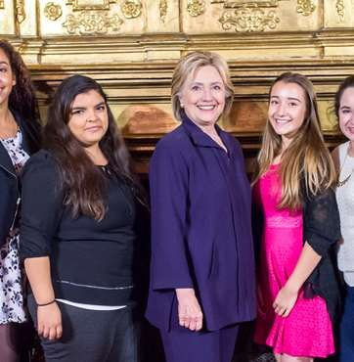
GOALS
The Basics of a Lincoln
Douglas debate
How to Choose a Winner
How to Fill out a Ballot

Slide 5
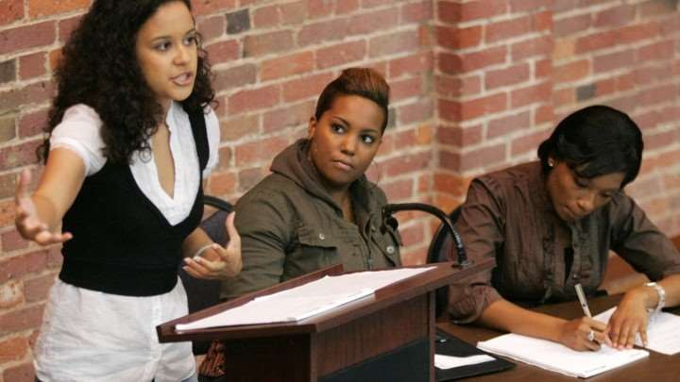
1. THE BASICS OF LINCOLN DOUGLAS DEBATE

Slide 6
THE BASICS OF A LINCOLN- DOUGLAS DEBATE
SPEECH ORDER | TIMING
Affirmative constructive (AC) | 6 minutes
The negative speaker cross- examines the affirmative speaker. | 3 minutes
Negative constructive (NC) | 7 minutes
The affirmative speaker cross- examines the negative speaker. | 3 minutes
First affirmative rebuttal (1AR) | 4 minutes
Negative rebuttal (NR) | 6 minutes
Second affirmative rebuttal (2AR) | 3 minutes
Each side has 4 minutes of preparation time they may use between speeches as they wish. | 8 minutes (total)
There is 1 Affirmative Constructive and 1 Negative Constructive.
Each Constructive speech is followed by a 3-minute Cross
Examination.
There is then an Affirmative Rebuttal speech, followed by a Negative Rebuttal speech, followed by a final Affirmative Rebuttal speech.
→ Debaters use these speeches to refute or defend already existing arguments and narrow down their arguments
Debaters have 4 total minutes of Prep Time to use before speeches.

Slide 7
THE BASICS OF LINCOLN-DOUGLAS DEBATE: TWO JUDGE DUTIES
You are the official time-keeper
The one-pager you rec’d has speech order, speech
responsibilities and speech times.
You should disregard new arguments made in the rebuttals (new arguments are illegal, new interpretations of existing arguments are allowed).
New debaters (or tricky debaters) may try to slip in a new argument in a rebutta. Please disregard this.

Slide 8
Facilitate introductions
Greet debaters
throughout the day
Listen actively
Share your reactions to
students’ work and ideas
Push students and
celebrate growth
BE A CREATOR OF COMMUNITY

Slide 9
YOUR RESPONSIBILITIES AS A JUDGE
Before
the Round
During
the Round
After
the Round
Keep time Listen actively Take notes
Congratulate students but DO NOT give verbal feedback
Determine a winner
and write an RFD
Head to the room number indicated on your text
Open your ballot and
press “Start Round”

Slide 10
2. HOW TO CHOOSE A WINNER

Slide 11
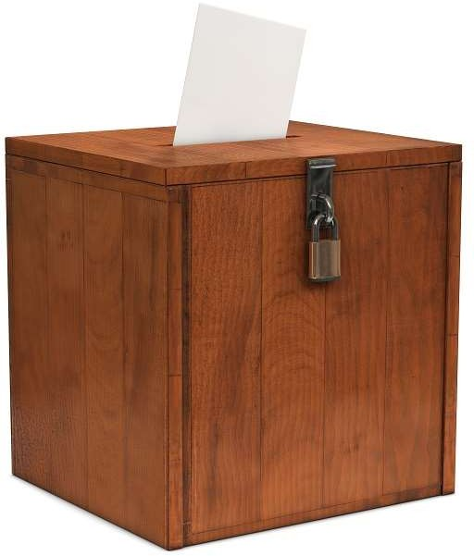
THE RESOLUTION
Resolved: In a democracy, voting ought to be compulsory.

Slide 12
THE TEAMS
Affirmative:
Negative:
For the resolution!
Against the resolution!

Slide 13
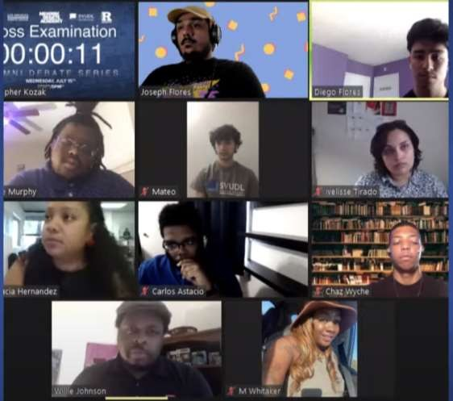
ONLINE DEBATE!
Judge
First
Here is a screen shot from a recent online debate held by SVUDL and their partners.
Affirmative
First
The zoom room has become a classroom!
Judge
Negative
You can have students label their “names” by their last name and side (AFF or NEG) to make judging easier.
Judge
Second
Affirmative
Second
Negative

Slide 14
HOW TO CHOOSE A WINNER
The affirmative usually has the burden to prove their value is advantageous. NEITHER TEAM should offer a formal plan or counterplan.

Slide 15
DETERMINING A WINNER
What to Consider
Strength of arguments
Claims, reasons, and
supporting evidence
Refutation of opponent’s arguments
What Not to Consider
Your personal opinion
Presentation skills or style
Pronunciation, accent, or
reading fluency
Arguments not explicitly made
by debaters
Arguments made during cross- ex
Minor points made at the beginning of the round

Slide 16
COMMON HABITS IN NEW DEBATERS
DEVELOPING PRESENTATION SKILLS
PAUSING WHILE
SPEAKING
STOPPING EARLY
LOOKING AT OPPONENT’S EVIDENCE
UNCERTAIN ABOUT WHOSE TURN IT IS

Slide 17
MORE EXPERIENCED DEBATERS
SPEAK FASTER
USE TERMINOLOGY FOR SPECIFIC TYPES OF ARGUMENTS
MAY RUN OUT OF
TIME
MAY BE MORE COMPETITIVE WITH ONE ANOTHER

Slide 18
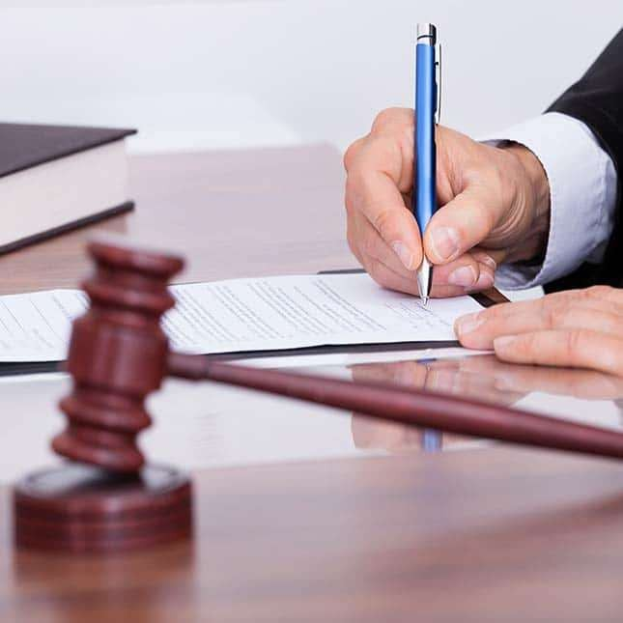
4. HOW TO FILL OUT A BALLOT

Slide 19
HOW TO FILL OUT A BALLOT
To see your current ballots, log-in and go to your account dashboard by clicking your username/email in the upper part of the page.
Make sure to click "Start Round" to let the tournament know that you're aware you're judging.

Slide 20
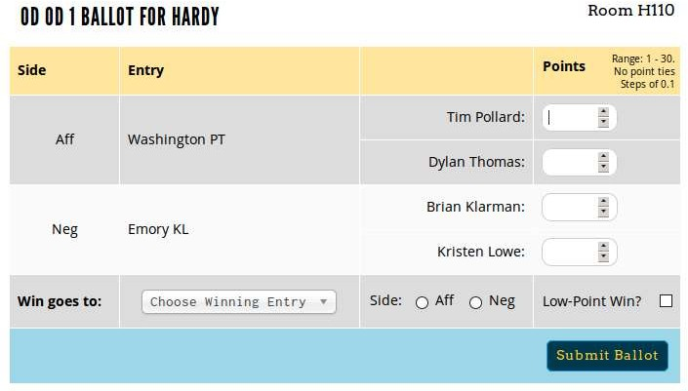
HOW TO FILL OUT A BALLOT
For each ballot, fill out the speaker points, choose a winner and the corresponding school, then click "Submit Ballot."

Slide 21
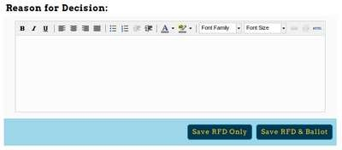
HOW TO FILL OUT A BALLOT
During the round, before you submit
your ballot, you should fill out a
Reason for Decision (RFD) below the
ballot.
This will be saved and available to
competitors and their coaches.
A good RFD is specific. It is typically at least a paragraph, often longer.
A good RFD describes either how the
affirmative met their burden of proof
or how the AFF was defeated by the NEG.
A good RFD always explains to the
losing side what they could have done to win the debate.

Slide 22
HOW TO FILL OUT A BALLOT
After submitting your ballot the first time, you must confirm the ballot - you'll be shown the data you entered the first time, and then the option to confirm or re-enter if you made a mistake.

Slide 23
WRITING A REASON FOR DECISION (RFD)
Strong RFD
At least 2 sentences
States strongest arguments
Compares or weighs arguments
Explains how enacting the plan would make the world a better place
Weak RFD
1-2 sentences
Vague, generic
Doesn’t compare or weigh arguments
Discusses superficial items
(presentation, clarity)

Slide 24
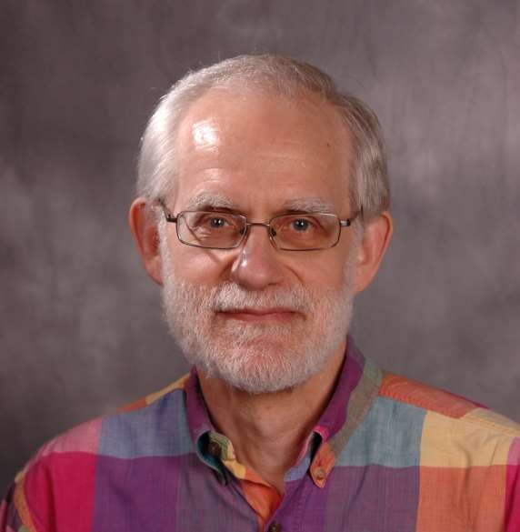
POSITIVE FRAMING…
“You could have been anywhere this Saturday, perhaps you wish you were in your bed sleeping.
But you worked hard and came here to participate in the most venerable tradition of American
democracy, the public debate. I
salute you for it.”
-- Fred Sternhagen
Director of Debate, Concordia University

