Slide 1
JUDGING PUBLIC FORUM

Slide 2
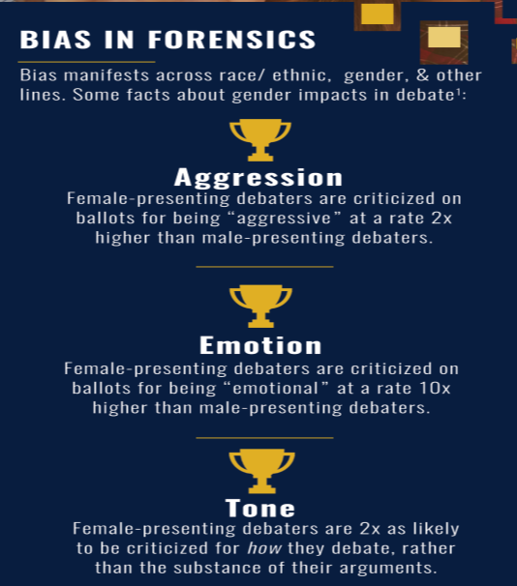
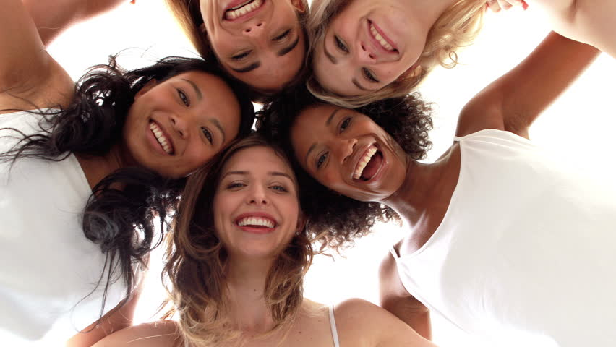

Slide 3
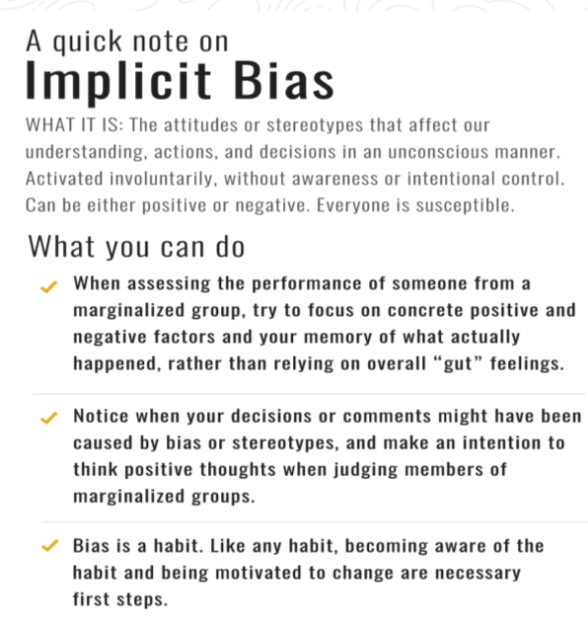

Slide 4
GOALS
The Basics of a Public Forum
How to Choose a Winner
How to Fill out a Ballot

Slide 5
1. THE BASICS OF PUBLIC FORUM DEBATE

Slide 6
THE BASICS OF A PUBLIC FORUM DEBATE
SPEECH ORDER | TIMING:
1st Affirmative Constructive (1AC) | 4 min
1st Negative Constructive (1NC) | 4 min
Crossfire (1st 2 speakers) | 3 min
Affirmative Rebuttal | 4 min
Negative Rebuttal | 4 min
Crossfire (2nd 2 speakers) | 3 min
Aff Summary | 3 min
Neg Summary | 3 min
GRAND CROSSFIRE (all 4 speakers) | 3 min
Aff Final Focus | 2 min
Neg Final Focus | 2 min
In CHSSA there IS NO COIN FLIP, and AFF always speaks first
- There are four 4-minute Constructives (1st aff, 1st Neg, Aff Rebuttal, Negative Rebuttal
- Each pair of Constructive speeches is followed by a 3-minute Crossfire.
- There are then two 3-minute Summary speeches.
Debaters use these speeches to refute or defend already existing arguments and narrow down their arguments
- There are two 2 minute Final Focus speeches
Debaters use these speeches to bring the arguments down to 1 or 2 arguments, and weigh the round
- Debaters have 3 total minutes of Prep Time to use before speeches.

Slide 7
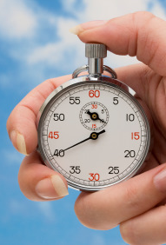
THE BASICS OF PUBLIC FORUM DEBATE: TWO JUDGE DUTIES
1. You are the official time-keeper
The one-pager you rec’d has speech order, speech responsibilities and speech times.
2. You should disregard new arguments made in the Summary and Final Focus (new arguments are illegal, new interpretations of existing arguments are allowed).
New debaters (or tricky debaters) may try to slip in a new argument in a rebuttal (especially the last final focus). Please disregard this.

Slide 8
BE A CREATOR OF COMMUNITY
Facilitate introductions
Greet debaters throughout the day
Listen actively
Share your reactions to students’ work and ideas
Push students and celebrate growth

Slide 9
YOUR RESPONSIBILITIES AS A JUDGE
Before the Round
During the Round
After the Round
Head to the room number indicated on your text
Open your ballot and press “Start Round”
Keep time
Listen actively
Take notes
Congratulate students but DO NOT give verbal feedback
Determine a winner and write an RFD

Slide 10
2. HOW TO CHOOSE A WINNER

Slide 11
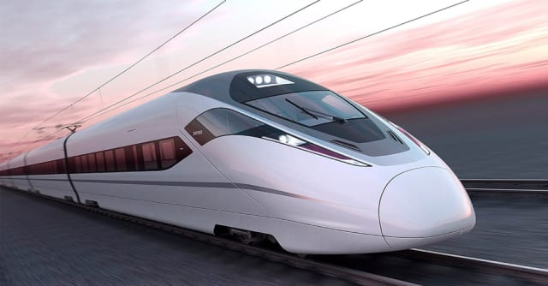
THE RESOLUTION
Resolved: The United States Federal Government should substantially increase its investment in high-speed rail.

Slide 12
THE TEAMS
Affirmative: For the resolution!
Negative: Against the resolution!

Slide 13
ONLINE DEBATE!
Judge
First Affirmative
Here is a screen shot from a recent online debate held by SVUDL and their partners.
The zoom room has become a classroom!
You can have students label their “names” by their last name and speech order to make judging easier.
First Negative
Judge
Judge
Second Affirmative
Second Negative

Slide 14
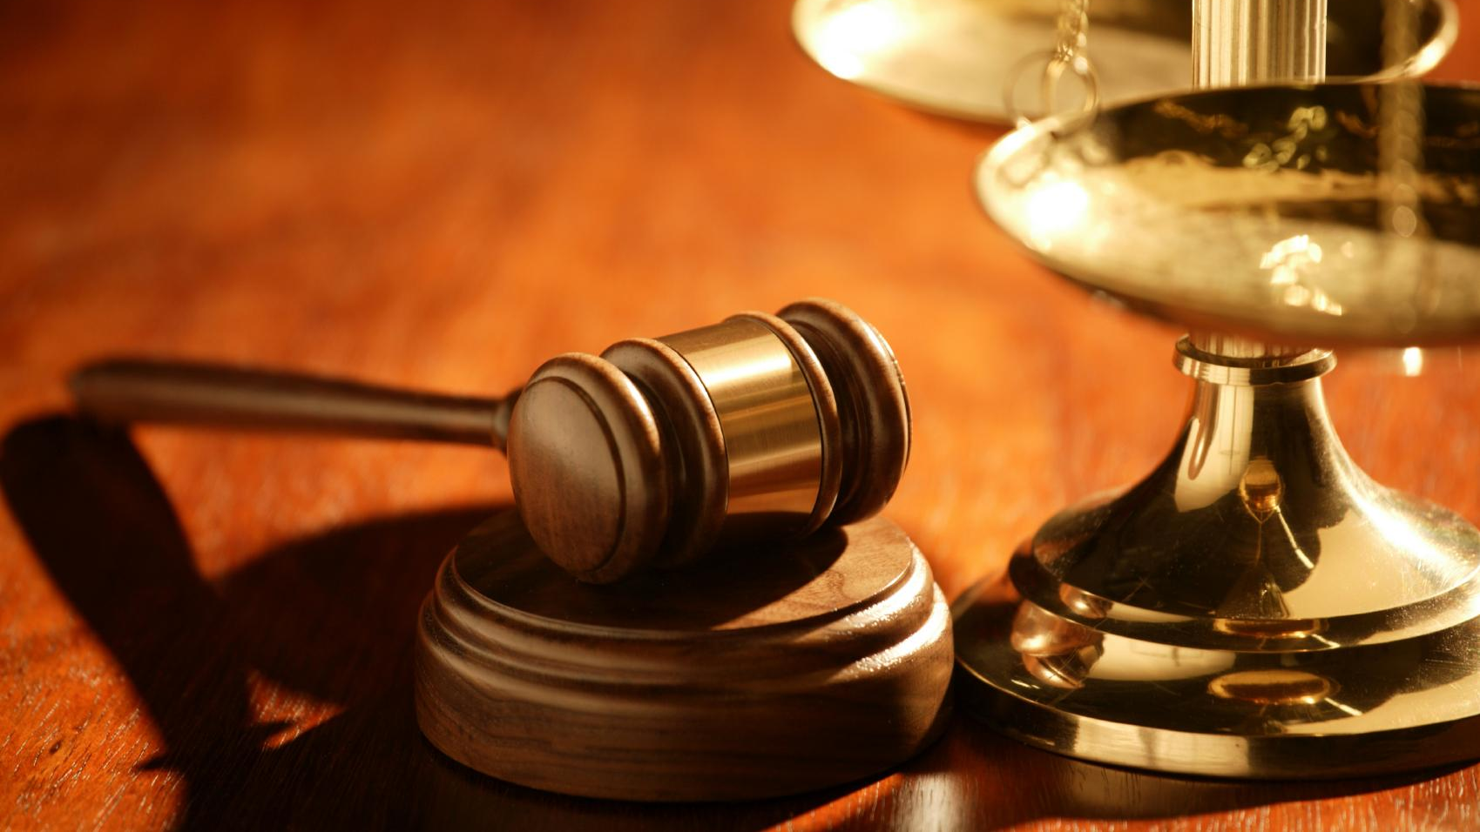
HOW TO CHOOSE A WINNER: THE AFFIRMATIVE BURDEN OF PROOF
The affirmative usually has the burden to prove the resolution is true, or advantageous. NEITHER TEAM should offer a formal plan or counterplan. SOME resolutions have a built in plan (example Medicare for All act of 2019), some are merely statements of contested fact

Slide 15
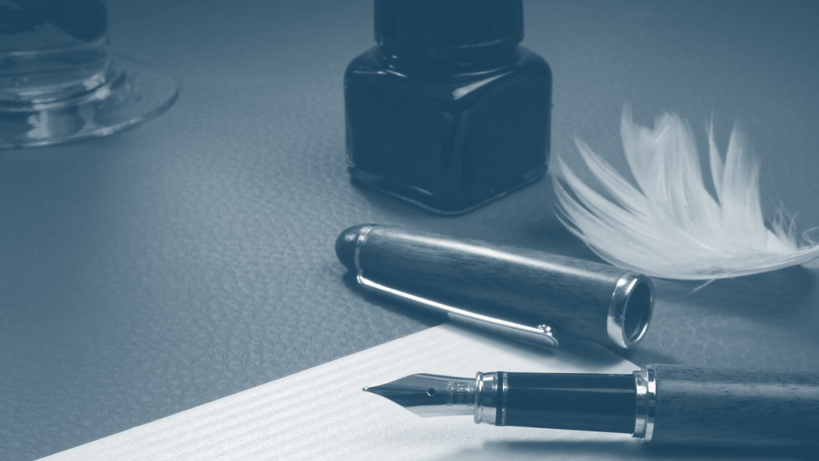
HOW TO CHOOSE A WINNER: THE NEGATIVE BURDEN OF REJOINDER
The Negative can win by showing the resolution is not true, or the resolution is not advantageous. The negative should not be defending a specific plan.

Slide 16
DETERMINING A WINNER
What to Consider
What Not to Consider
Strength of arguments
Claims, reasons, and supporting evidence
Refutation of opponent’s arguments
Your personal opinion
Presentation skills or style
Pronunciation, accent, or reading fluency
Arguments not explicitly made by debaters
Arguments made during cross-ex
Minor points made at the beginning of the round

Slide 17
COMMON HABITS IN NEW DEBATERS
DEVELOPING PRESENTATION SKILLS
PAUSING WHILE SPEAKING
STOPPING EARLY
LOOKING AT OPPONENT’S EVIDENCE
UNCERTAIN ABOUT WHOSE TURN IT IS

Slide 18
MORE EXPERIENCED DEBATERS
SPEAK FASTER
USE TERMINOLOGY FOR SPECIFIC TYPES OF ARGUMENTS
MAY RUN OUT OF TIME
MAY BE MORE COMPETITIVE WITH ONE ANOTHER

Slide 19
4. HOW TO FILL OUT A BALLOT

Slide 20
HOW TO FILL OUT A BALLOT
To see your current ballots, log-in and go to your account dashboard by clicking your username/email in the upper part of the page.
Make sure to click "Start Round" to let the tournament know that you're aware you're judging.

Slide 21
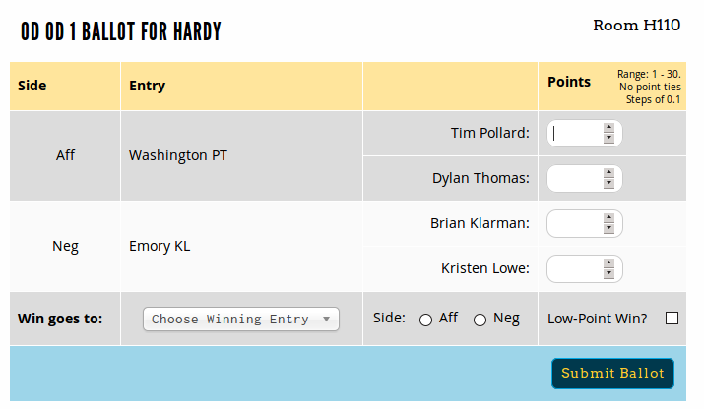
HOW TO FILL OUT A BALLOT
For each ballot, fill out the speaker points, choose a winner and the corresponding school, then click "Submit Ballot."

Slide 22
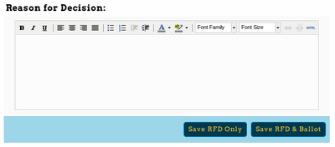
HOW TO FILL OUT A BALLOT
During the round, before you submit your ballot, you should fill out a Reason for Decision (RFD) below the ballot.
This will be saved and available to competitors and their coaches.
A good RFD is specific. It is typically at least a paragraph, often longer.
A good RFD describes either how the affirmative met their burden of proof or how the AFF was defeated by a NEG strategy.
A good RFD always explains to the losing side what they could have done to win the debate.

Slide 23
HOW TO FILL OUT A BALLOT
After submitting your ballot the first time, you must confirm the ballot - you'll be shown the data you entered the first time, and then the option to confirm or re-enter if you made a mistake.

Slide 24
WRITING A REASON FOR DECISION (RFD)
Strong RFD
Weak RFD
At least 2 sentences
States strongest arguments
Compares or weighs arguments
Explains how enacting the plan would make the world a better place
1-2 sentences
Vague, generic
Doesn’t compare or weigh arguments
Discusses superficial items (presentation, clarity)

Slide 25
EXAMPLE RFD
I vote Neg in this debate because they won a significant risk of the Elections Disadvantage. They won that Trump would use criminal justice reform to win undecided voters in swing states, tipping the election. This would have dire consequences, as a second Trump term would make it impossible to address global warming.
The aff won that passing their body cameras reform would enhance police accountability and decrease police violence towards minority communities., but I felt the magnitude of the disadvantage outweighed the case impact.
The affirmative could have won the debate if they demonstrated that the probability of a Trump victory was lower than the Negative argued. They also could have won if they demonstrated that decreasing police brutality against minority communities ought to take precedence over hypothetical future climate impacts.

Slide 26
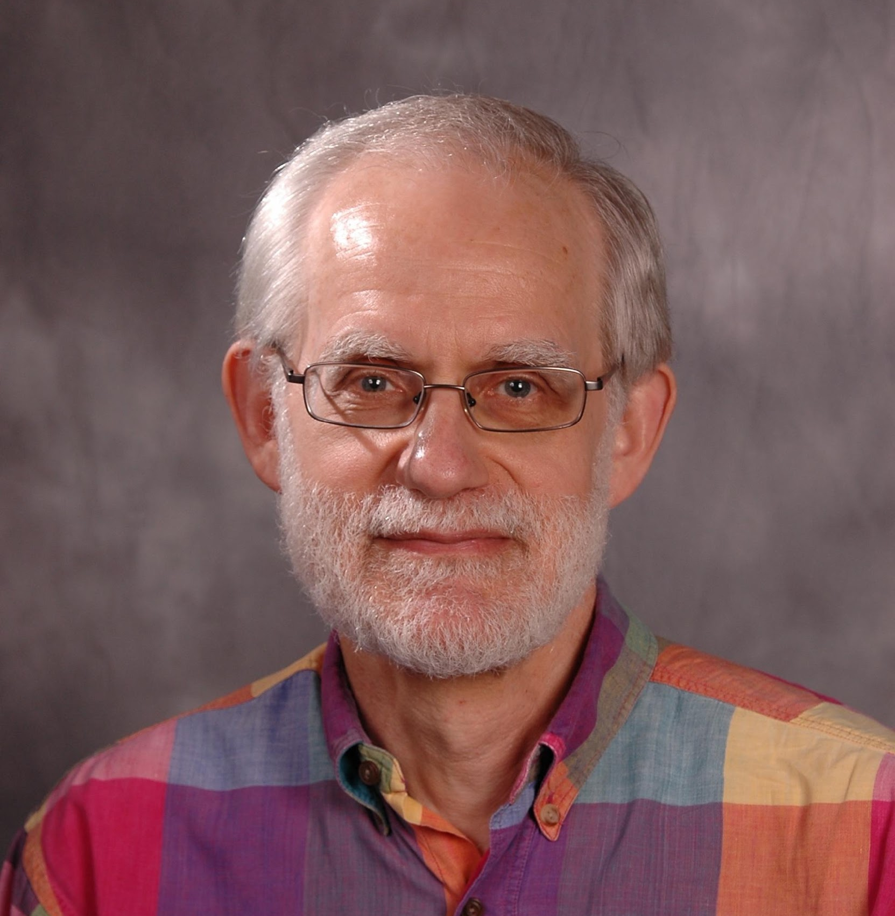
POSITIVE FRAMING…
“You could have been anywhere this Saturday, perhaps you wish you were in your bed sleeping. But you worked hard and came here to participate in the most venerable tradition of American democracy, the public debate. I salute you for it.”
-- Fred Sternhagen
Director of Debate, Concordia University

